Slide 1
Lecture 6
Android - Activities

Slide 2
Android - Activities
An activity represents a single screen with a user interface.
If you have worked with C, C++ or Java programming language then you must have seen that your program starts from main() function. Very similar way, Android system initiates its program with in an Activity starting with onCreate() callback method.

Slide 3
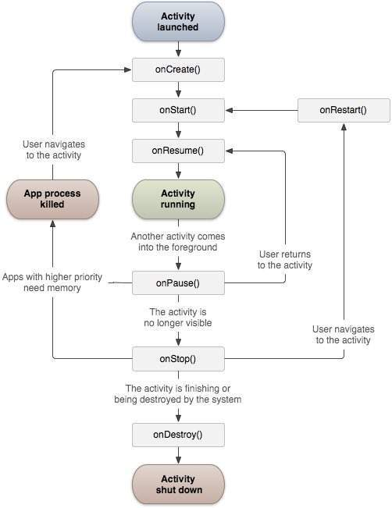
Android - Activities

Slide 4
Android - Activities
Callback | Description
onCreate() | This is the first callback and called when the activity is first created.
onStart() | This callback is called when the activity becomes visible to the user.
onResume() | This is called when the user starts interacting with the application.
onPause() | The paused activity does not receive user input and cannot execute any code and called when the current activity is being paused and the previous activity is being resumed.
onStop() | This callback is called when the activity is no longer visible.
onDestroy() | This callback is called before the activity is destroyed by the system.
onRestart() | This callback is called when the activity restarts after stopping it.

Slide 5
Example of Android Activities
public class MainActivity extends Activity
{
protected void onCreate(Bundle savedInstanceState)
{
super.onCreate(savedInstanceState);
setContentView(R.layout.activity_main);
Toast.makeText(getApplicationContext(), "on create method is running", Toast.LENGTH_SHORT).show();
}
protected void onStart()
{
super.onStart();
Toast.makeText(getApplicationContext(), "on start method is running ", Toast.LENGTH_SHORT).show();
}
protected void onResume()
{
super.onResume();
Toast.makeText(getApplicationContext(), "on resume method is running ", Toast.LENGTH_SHORT).show();
}

Slide 6
Example of Android Activities
protected void onPause() {
super.onPause();
Toast.makeText(getApplicationContext(), "on pause method is running ", Toast.LENGTH_SHORT).show();
}
protected void onStop()
{
super.onStop();
Toast.makeText(getApplicationContext(), "on stop method is running ", Toast.LENGTH_SHORT).show();
}
protected void onDestroy()
{
super.onDestroy();
Toast.makeText(getApplicationContext(), "on destroy method is running ", Toast.LENGTH_SHORT).show();
}
protected void onRestart()
{
super.onRestart();
Toast.makeText(getApplicationContext(), "on restart method is running ", Toast.LENGTH_SHORT).show();
}
}

Slide 7
Output of Example
When we run this Project from eclipse then output:
OnCreate Method is Running.
OnStart Method is Running.
OnResume Method is Running.
When we close this activity then output:
OnPause Method is Running.
OnStop Method is Running.
OnDestroy Method is Running.
When we run again this project from Menus of Emulator then output:
OnCreate Method is Running.
OnStart Method is Running.
OnResume Method is Running.
When we minimize this activity then output:
OnPause Method is Running.
OnStop Method is Running.
5. When we run again this project from Menus of Emulator then output:
OnRestart Method is Running.
OnStart Method is Running.
OnResume Method is Running.

